Slide 1

May Jun claims tracking analysis
Aug 14, 2019 (A member of KBZ Group)

Slide 2
Background
IKBZ introduced a new motor claims process on April 01 2019
This second analysis seeks to confirm or rebut burgeoning trends identified earlier
The main hypotheses were:
The time taken for motor claims processing is getting shorter
Document preparation time is long
Using smart forms for surveyors is part of an answer to this
A large part of the time is spent waiting for repairs to be carried out
Hence repair time estimation would be useful
The time spent on internal document preparation is a bit long and should improve
There is a surprising gap between payment approval and actual payment

Slide 3
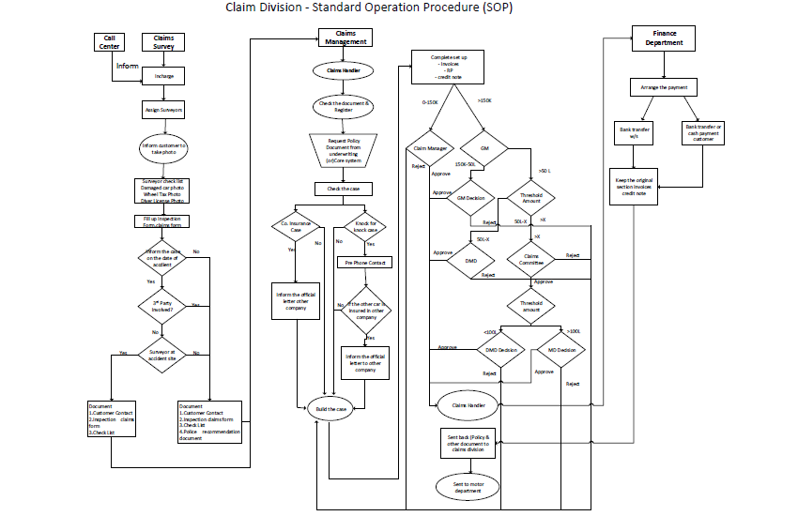
Recap: the process is a combined effort
Call Centre
Finance
Claims Surveyor
Claims Handler
Claims Management and Approval Layer

Slide 4
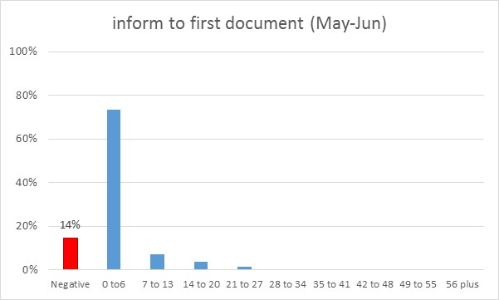
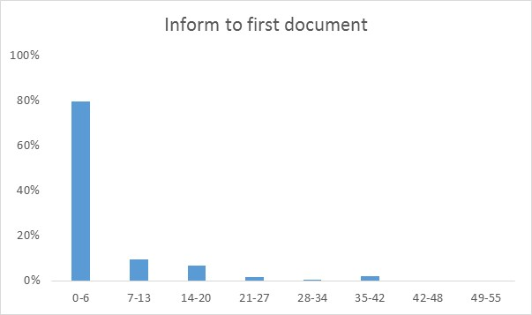
Better at obtaining the first document, but process issues
The long tail of April is milder,
But in 14% of cases, docs are received
before being informed of the accident

Slide 5
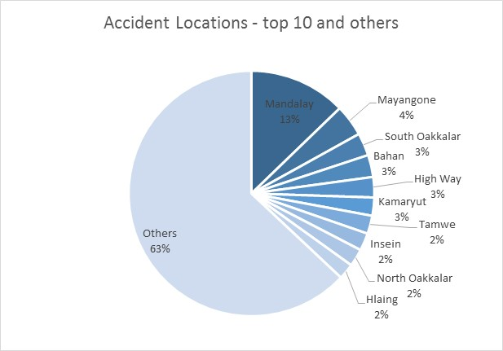
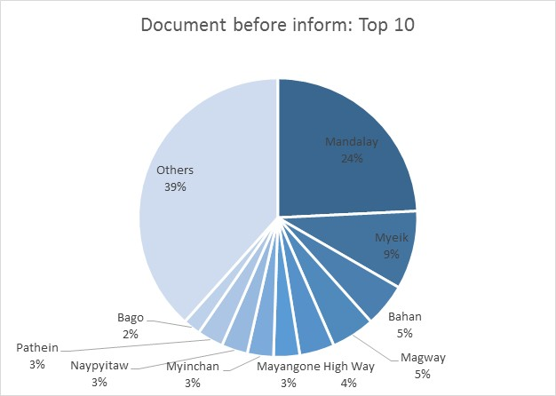
Better at obtaining the first document, but process issues
Mandalay is almost 2x more likely to exhibit different process at inform stage

Slide 6
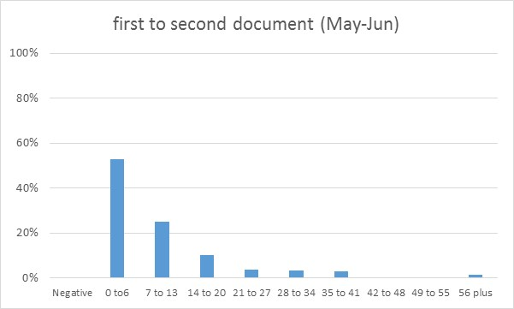
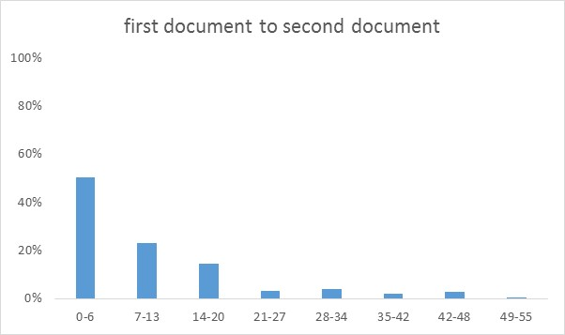
It still can take a while to collect all documets
There is little change in the time taken between completion of 2 sets of documents

Slide 7
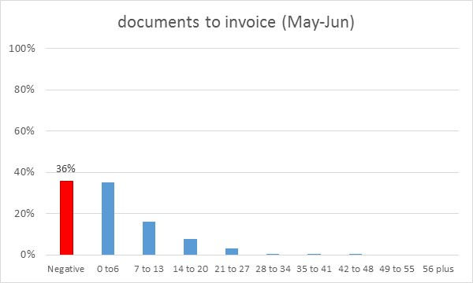
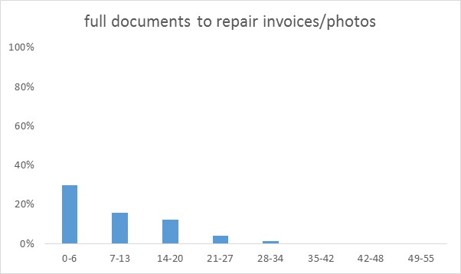
Most time is spent at workshops, but again process issues
Repair time is still long, but in 36% of cases, invoices are received without all complete documents

Slide 8
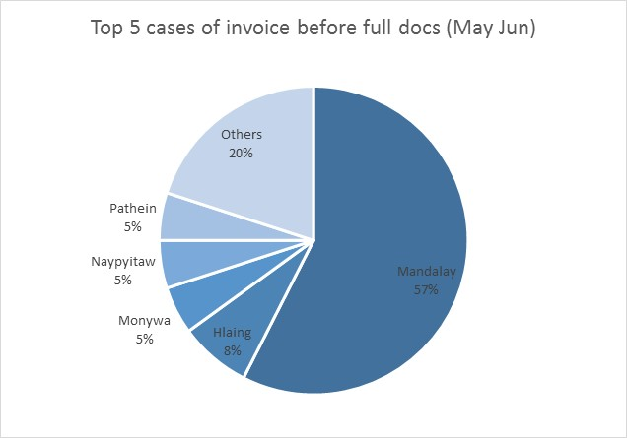
Mandalay, again, exhibits different process from the rest
Mandalay
is more than 4x more likely to exhibit different process while collating documents

Slide 9
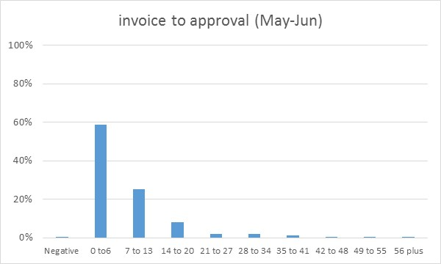
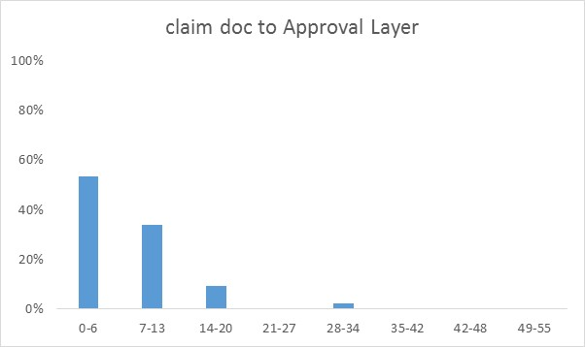
Document preparation for approval is still time consuming
Preparing the data for approval takes long, one already called out target area for operational efficiency

Slide 10
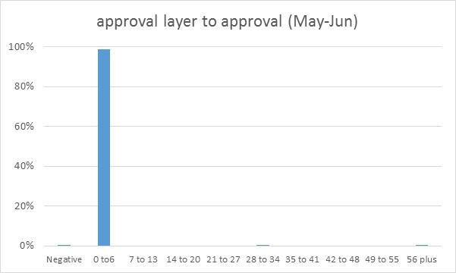
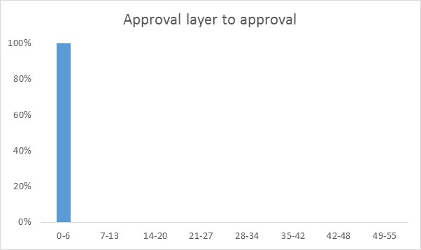
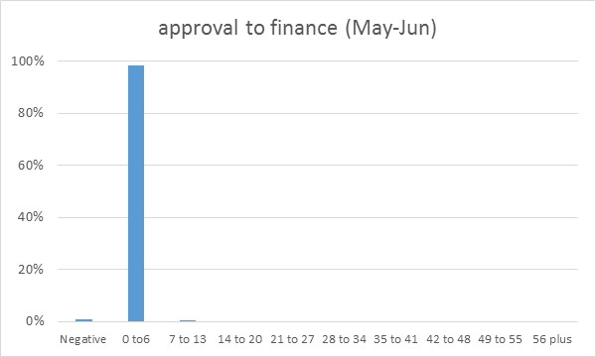
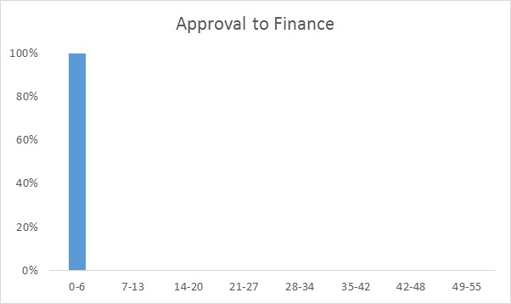
Approvals, limits, and delivery to finance: success!

Slide 11
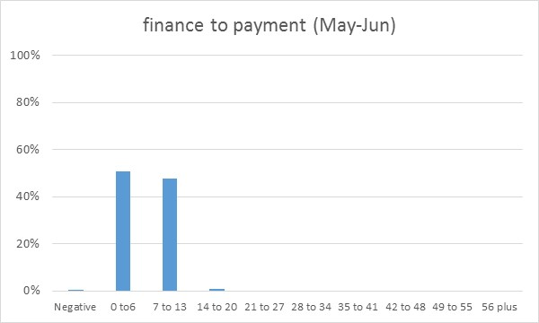
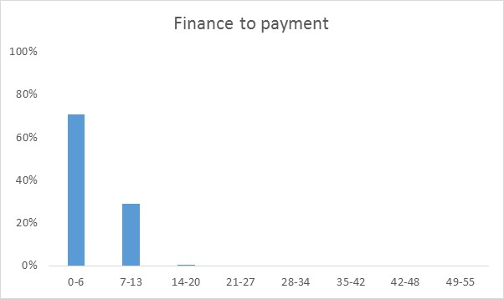
In May-Jun, Finance took longer to pay, impacting TAT
The last 2 months the finance processing has slowed down. This should be investigated.

Slide 12
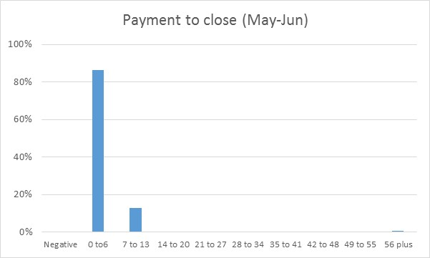
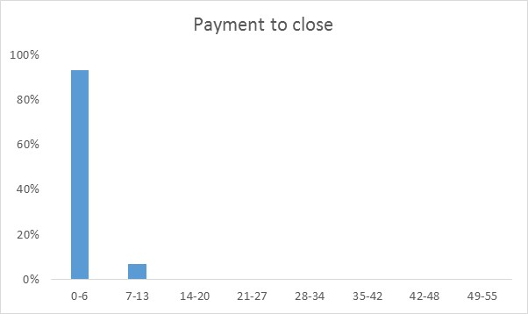
Case closure is fairly quick
Claims cases are closed fairly quickly after payment is done

Slide 13
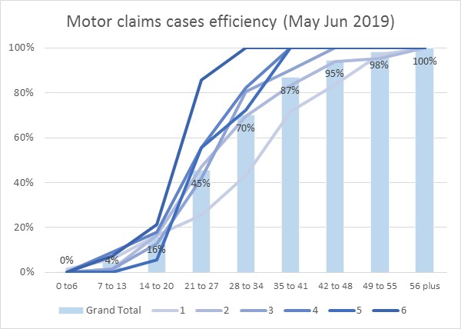
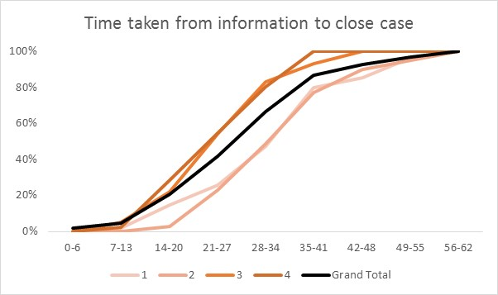
The change in process is stabilizing and is faster
Apart from the 1st week of May, all other weeks show consistent performance.
Overall, slightly more than 2/3 of cases are cleared within a month*
* Data is biased since some cases, especially in the last 2 weeks of Jun have not been completed, but overall result stands

Slide 14
Conclusion and Next Steps
The time takes to process motor vehicle claims is getting shorter and with less variability
The new process implemented on April 1 is delivering results
The claims and ops teams can start thinking of SLAs
There still are areas of improvement
The case of Mandalay should be investigated, their processes seem different
Gathering and preparing the data for approval is still an issue – operational efficiency is targeting this area in 2019-2020
Finance is still taking unexpectedly long to pay, alternative methods should be considered as long as workshops are agreeable (to be verified)

Slide 15
Appendix

Slide 16
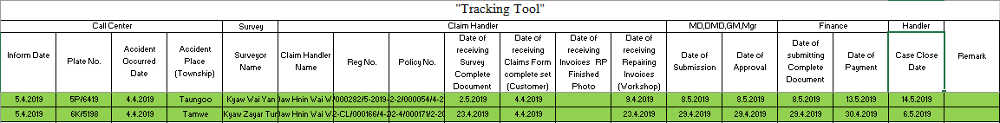
Sample of tracking tool

